Slide 1
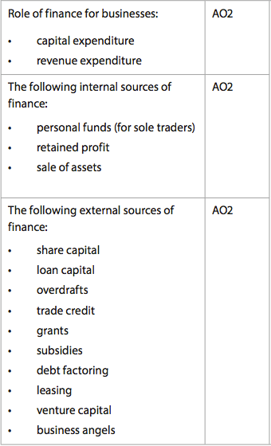
Finance & Money
What do businesses specifically need it for?
Where do they get it?
From range of sources: loans, selling unused assets

Slide 2
Categorization (in terms of purpose)
Capital expenditure
Spent on purchasing fixed assets.
Since fixed assets tend to be expensive, sources of finance for capital expenditure tend to come from mid and long-term sources.
Fixed assets provide collateral. Subject to depreciation
AO2 - Role of finance for Business

Slide 3
Categorization (in terms of purpose)
Revenue expenditure
Payments for the daily running of the business, e.g. wages, raw materials, electricity
Indirect costs, e.g. rent, insurance, advertising.
AO2 - Role of finance for Business

Slide 4
INTERNAL FINANCE
Within the business
Personal funds
Retained Profits
Sale of assets
AO2 – Internal sources of finance

Slide 5
INTERNAL FINANCE
Personal funds
main source for sole traders & partners.
AO2 – Internal sources of finance

Slide 6
INTERNAL FINANCE
Retained profits
Often used for purchasing or upgrading fixed assets.
May also be kept in a contingency fund.
It’s beneficial because the business doesn’t rely on borrowing.
May not be enough
It means less of it available for shareholders
AO2 – Internal sources of finance

Slide 7
The Coca-Cola Company announced record sales and profits for the three months to October 2008 – net profits exceeded $1.8 billion. It has over $5 billion in cash with high profit margins and its share price has not slumped in the same way as that of most companies during the global recession. It can afford to launch more new products and enter new markets without the need to borrow or sell further shares.
AO2 – Internal sources of finance

Slide 8
Do not assume that a profitable business is cash rich – and that it can use all of its profits as a source of finance for future projects. In practice, profits are often ‘tied up’ in money owed to the business by debtors or have been used to finance increased stocks or replace equipment.
AO2 – Internal sources of finance

Slide 9
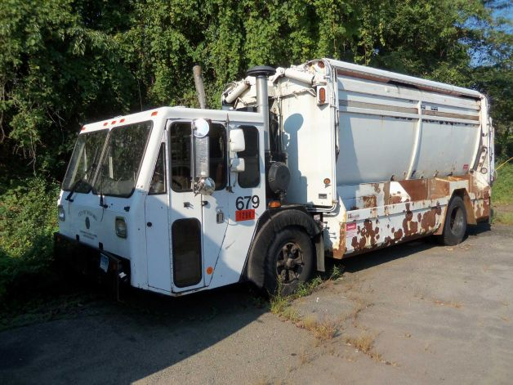
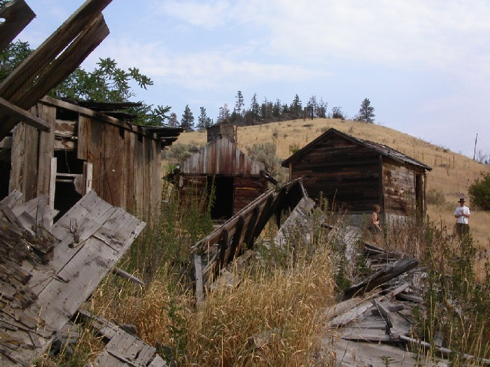
INTERNAL
Selling assets
Dormant assets (unused) can be sold. Coca-Cola land and CityMall
Replaced machinery, used computer equipment, out of-season stock (at a discount)
If relocation occurs, sale of buildings/land
AO2 – Internal sources of finance

Slide 10
In 2008, AIG insurance company planned to sell off some of its subsidiaries to raise cash to help the company through difficult times. For example, the sale of one of the world’s largest aircraft leasing companies, International Lease Finance, could raise several billion dollars. In the previous year, HSBC sold its huge London headquarters for $2 billion, but will stay in the building and lease it back from the new owners – at an annual rent of $80 million.
AO2 – Internal sources of finance

Slide 11
EXTERNAL FINANCE
Examples are:
Share capital
Loan Capital
Overdrafts
Trade credit
Grants
Subsidies
Debt Factoring
Leasing
AO2 – External sources of finance

Slide 12
EXTERNAL FINANCE
Examples are:
Ventre Capital
Business angels
External sources will demand a financial reward, such as interest or dividends
External sources may reduce the level of business ownership for current owners
AO2 – External sources of finance

Slide 13
EXTERNAL FINANCE
Share capital
Selling shares
tends to be source for limited companies.
Remember the difference between ‘private’ and ‘public’ limited companies?
What’s IPO? or GOING PUBLIC?
AO2 – External sources of finance

Slide 14
EXTERNAL FINANCE
Share capital
Two main types of share capital:
Preference shares: preference shareholders earn a fixed dividend from the company’s profit. They may be cumulative
They provide a safe income stream and low-risk investment when compared to ordinary shares.
Preference shares are often non-voting shares
AO2 – External sources of finance

Slide 15
EXTERNAL FINANCE
Ordinary shares: a.k.a equity capital. They’re the vast majority of shares.
Dividends are unknown, based on profits (they fluctuate).
Payment is received after preference shareholders.
Voting rights
They carry more risk but gain more dividend during good periods.
AO2 – External sources of finance

Slide 16
EXTERNAL FINANCE
Shares – secondary market
Share price – impact on company
AO2 – External sources of finance

Slide 17
EXTERNAL FINANCE
Loan capital
Obtained by commercial lenders, such as banks.
Mid to long-term. Interest can be fixed or variable.
AO2 – External sources of finance

Slide 18
EXTERNAL FINANCE
Overdrafts
If you have $10,000 in your bank account, how much can you spend?
Commonly used when businesses have minor cash flow problems.
Used as short-term source of finance. Interest is charged on daily basis
AO2 – External sources of finance

Slide 19
EXTERNAL FINANCE
Trade credit
‘buy now & pay later’
Debtors – Creditors
Creditors usually allow between 30-60 days for their customers to pay.
AO2 – External sources of finance

Slide 20
EXTERNAL FINANCE
Government grants
Financial aid to support business activities
For small business start-ups or to help stimulate economic activity in regions or industries that may be facing particular problems.
AO2 – External sources of finance

Slide 21
General Motors is in deep trouble. Its share price fell to a 60-year low in November 2008 – just $3.36. Some analysts believe the price could fall to below $1 a share, so to try to raise finance from selling new shares would be pointless – who would want to buy them? The company already has $300 billion of debt and it made a huge loss of $4.2 billion in just three months. It is selling assets – closed factory sites, for example – to raise funds, and has also appealed to the US government for emergency finance. GM already has access to $25 billion of cheap US government loans and grants to help it over the current crisis.
Source: http://newsvote.bbc.co.uk and http://articles.moneycentral.msn.com (adapted)
AO2 – External sources of finance

Slide 22
EXTERNAL FINANCE
Government subsidies
Purpose: to reduce costs of production, to provide benefits to society.
What subsidies can you identify in UAE?
AO2 – External sources of finance

Slide 23
EXTERNAL FINANCE
Debt factoring
Selling of claims over debtors to a debt factor in exchange for immediate liquidity – only a proportion of the value of the debts will be received as cash
Most factoring service providers offer between 80-85% of the outstanding payments from debtors within 24 hours.
AO2 – External sources of finance

Slide 24
EXTERNAL FINANCE
Debt factoring
Major advantage over receiving money in 30-60 days - typical credit periods.
Immediate source of finance for businesses with cash flow problems.
AO2 – External sources of finance

Slide 25
Debt factoring
Case
Tiffany Stones Ltd. has a forecast cash flow deficit of $140,000 in two months time. It has also debtors totaling $180,000. The firm decides to use a factoring service that advances 80% of debtor balance.
Calculate and explain whether this decision would resolve the cash flow problem for the business
AO2 – External sources of finance

Slide 26
Leasing
If your business needed a machine to produce certain item and you didn't have the money to buy that machine, what are the alternatives?
A form of hiring.
Two parties: Lessor and Lessee
It can be cheaper to lease assets such as machinery, vehicles and buildings.
Leasing is suitable for businesses that do not have the initial capital to buy such assets
Maintenance and upgrading are provided by the lessor
Disadvantage: it's more expensive in the long term. Why?
AO2 – External sources of finance

Slide 27
Venture Capital
Sometimes called business angels
Risk capital invested in business start-ups or expanding small businesses, that have good profit potential, but do not find it easy to gain finance from other sources
Before investing, venture capitalists will look at a number of criteria, including:
ROI – Return on investment
People, team
Track record
Business plan
Understand the marke, Growth potential, Innovative, original ideas
AO2 – External sources of finance

Slide 28
Short-term
It refers to the current fiscal year.
In terms of external sources of finance, this means anything that has to be repaid to creditors and lenders within the next twelve months
Examples include trade credit, overdrafts or debt factoring (although debt factoring does not need to be paid back).
AO1 – Short, medium and long-term sources of finance

Slide 29
Medium-term
More than twelve months but less than five years.
In terms of sources of finance, mid-term sources might include commercial loans, and leasing agreements
AO1 – Short, medium and long-term sources of finance

Slide 30
Long-term
Any term after the next five years
Loan, share capital
The longer the period in question, the harder it becomes to plan effectively
AO1 – Short, medium and long-term sources of finance

Slide 31
Short, mid, long terms
These definitions will vary from business to business and industry to industry.
How do these definitions link to the overall aim and objectives of the business?
Industries heavily involved in R&D such as space technology or pharmaceuticals might see the mid-term as the next 10 years.
ICT industry might see the next 5 years as a relatively long term.
AO1 – Short, medium and long-term sources of finance

Slide 32
Making the financial decision
The size and the profitability of the business are clearly key considerations when managers make a financing choice. Small businesses are unlikely to be able to justify the costs of converting to public company. They might also have limited internal funds available if the existing profit levels are low.
AO3 - The appropriateness, advantages and disadvantages of sources of finance for a given situation

