Slide 1
CUEGIS
Section C Conceptual Essay

Slide 2
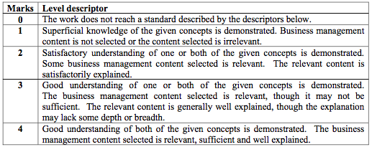
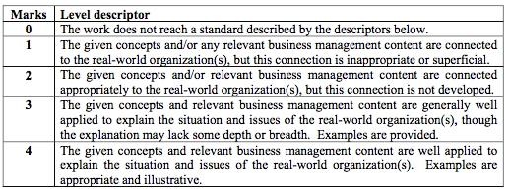
With reference to one organisation you have studies, compare and contrast the importance of innovation and ethics for Research and Development
Criterion A: Knowledge (K)
Criterion B: Application (A)
Criterion C: Reasoned Argument (R)
Criterion D: Structure (S)
Criterion E: Individuals and Societies (I)

Slide 3
- (K)
(K)
(K)
(S)

Slide 4
(A)
(A)
- (R)

Slide 5
(R)
(A)
(R)
- (K)
(I)

Slide 6
(A)
(R)
(K)
(I)
- (K)
- (A)
(R)

Slide 7
- (R)
(A)
(R)
(K)
(I)

Slide 8
- (S)

Slide 9
- (K)
(A)

Slide 10
- (S)

Slide 11
Assessment criteria | Marks awarded | Marks available
Criterion A | 2 | 4
Criterion B | 3 | 4
Criterion C | 2 | 4
Criterion D | 2 | 4
Criterion E | 2 | 4
Total | 11 | 20
Crit A: Knowledge
A weak 2. The candidate shows a satisfactory understanding of the concept of innovation, whereas the conception of ethics presented is contradictory (ethics is defined as practices that do not have harm on societies, while the concept is understood as not doing anything that harms a company’s reputation). A few business management theories are referred to explicitly (e.g. pester power, product life cycle) or implicitly (e.g. the idea of product development).
Crit B: Application
The candidate applies the concept of innovation and the business management theories well to her chosen organization (McDonald’s). The application is specific and examples relate to McDonald’s core operations, though they are somewhat simplistic. The examples are not effectively employed in the service of the question as McDonald’s Research and Development function is barely mentioned.
Crit C: Reasoned arguments
The candidate makes some relevant arguments (e.g. seeing two sides of the Happy Meal product). However, not all claims are justified (e.g. what evidence is there for McDonald’s having a very good brand image?). In the second half of the essay, in particular, the arguments lose force, and the last three body paragraphs are assertions with no evidence. The two concepts are not compared and contrasted, as required by the command term.
Crit D: Structure
Though the candidate has an introduction, a body, and a conclusion, the conclusion is weak, as is paragraphing in the second half of the essay (there are several very short paragraphs in succession, each with undeveloped ideas). The lack of a theoretical framework disturbs the clarity of the essay beyond the individual examples which are clearly explained.
Crit E: Individuals and societies
The answer is written mainly from the perspective of McDonald’s and its reputation, with some consideration given to various consumer groups in passing (e.g. vegetarians in India, children, people who want to access a fast food restaurant outside of business hours). However, these perspectives are not explored.

