Slide 1
Key words, ideas or phrases?
Think – Pair - Share

Slide 2
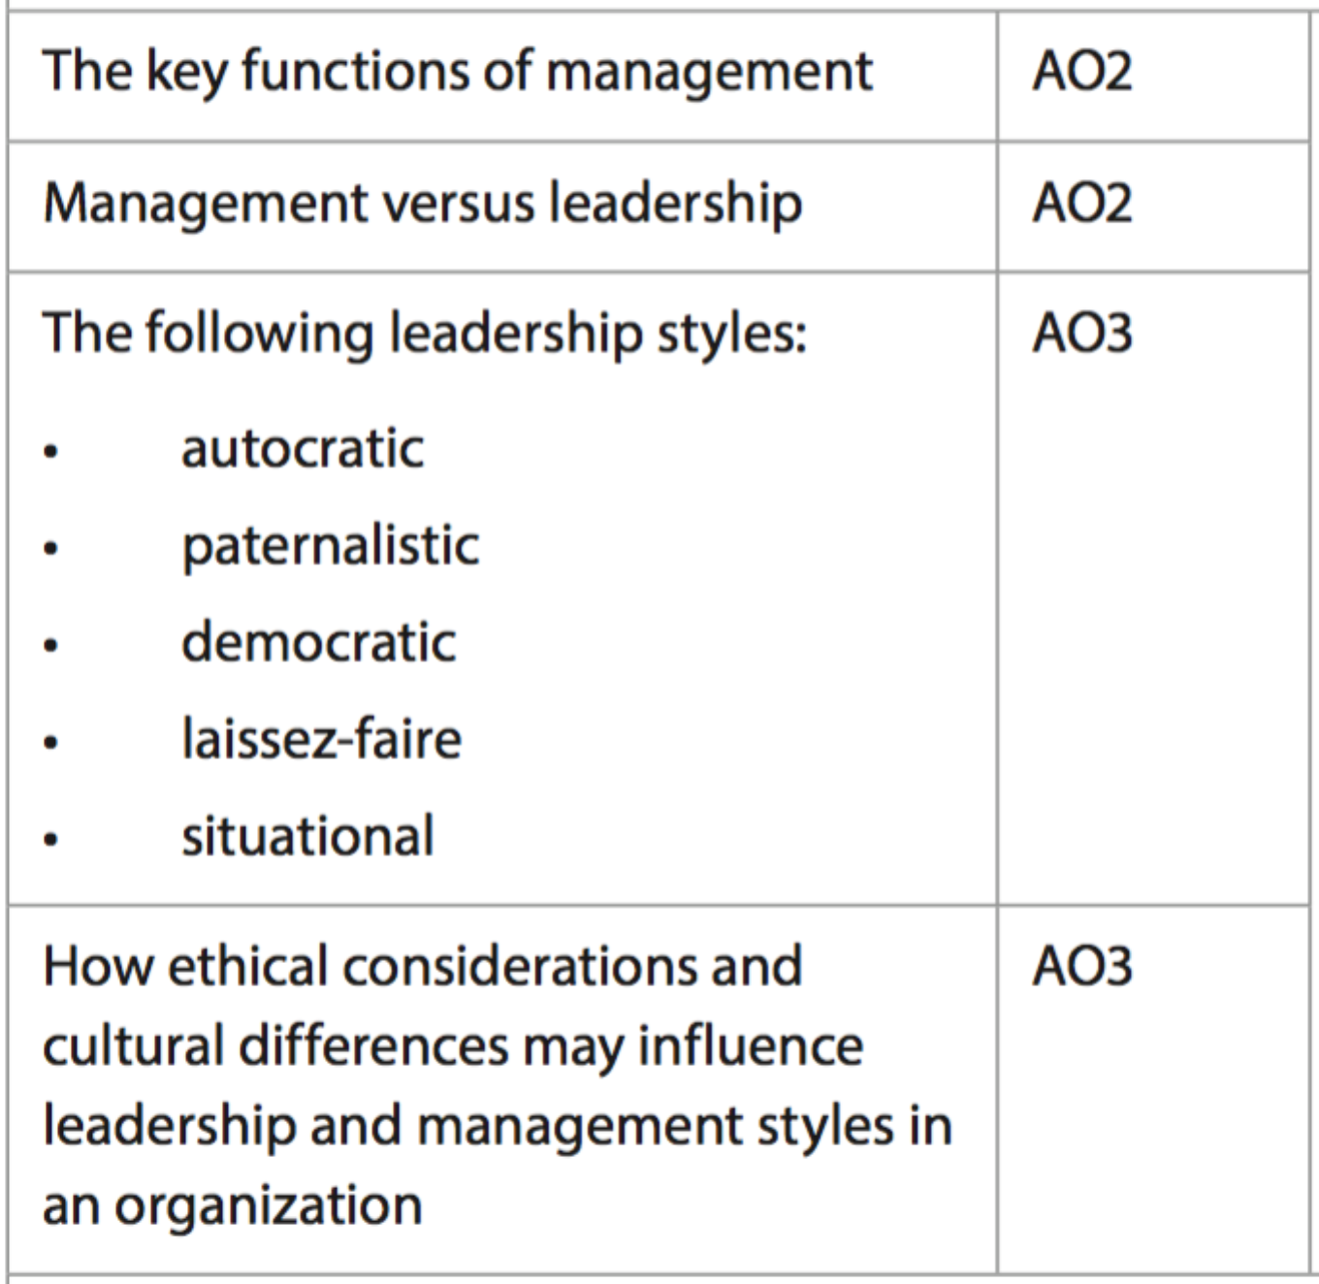
2.3 Leadership and Management
Leadership is about inspiring and motivating a group of people to achieve, or even exceed, an aim or target. Within business, leaders are usually given formal roles, and are known as managers who oversee employees.
Informally, leadership can be demonstrated by anyone. Leaders often have personal character traits that allow them to communicate and attract followers

Slide 3
Functions of Management
Henri Fayol 1916
Planning
Organising
Leading – Later expanded into ‘Commanding and Coordinating’
Controlling
More relevant to centralized organisations
Notes:
Henri Fayol's management theory is a simple model of how management interacts with personnel. Fayol's management theory covers concepts in a broad way, so almost any business can apply his theory of management. Today the business community considers Fayol's classical management theory as a relevant guide to productively managing staff. The management theory of Henri Fayol includes 14 principles of management. From these principles, Fayol concluded that management should interact with personnel in five basic ways in order to control and plan production.
1. Planning. According to Fayol's theory, management must plan and schedule every part of industrial processes. 2. Organizing. Henri Fayol argued that in addition to planning a manufacturing process, management must also make certain all of the necessary resources (raw materials, personnel, etc.) came together at the appropriate time of production. 3. Commanding. Henri Fayol's management theory states that management must encourage and direct personnel activity. 4. Coordinating. According to the management theory of Henri Fayol, management must make certain that personnel works together in a cooperative fashion. 5. Controlling. The final management activity, according to Henri Fayol, is for the manager to evaluate and ensure that personnel follow management's commands.

Slide 4
Functions of Management
Charles Handy Management Theory (different to culture theory)
Managers as General Practitioners – like doctors, they monitor health
Managers as confronters of dilemmas – solving problems is their responsibility
Managers as balancers of cultural mixes – they need to be culturally aware to reduce conflict, improve communication and decision-making

Slide 5
Functions of Management
Peter Drucker – Management by Objectives 1954
Managers are responsible for:
Setting organisational objectives
Organising tasks and people
Communicating and motivating employees
Measuring performance
Developing people
Drucker’s theory applies to more decentralized organisations
Notes:
Peter Drucker, also known as the Father of Modern Management Theory, coined leadership terms and strategies that are still used today. He advocated for a more flexible, collaborative workplace, and the delegation of power across the board.
According to Drucker, "management is doing things right; leadership is doing the right things." Unlike many early management theorists, Drucker thought that subordinates should have the opportunity to take risks, learn and grow in the workplace.
Drucker's management theory embodies many modern concepts, including:
Decentralization
Drucker was focused on decentralizing management in the workplace. He wanted all employees to feel valued and empowered, like their work and voice mattered. He believed in assigning tasks that inspire workers, and bringing supervisors and their subordinates together to achieve common, company goals.
Knowledge work
Knowledge workers are those whose jobs require handling or using information, such as engineers or analysts. Drucker placed high value on workers who solved problems and thought creatively. He wanted to cultivate a culture of employees who could provide insight and ideas.
Drucker also correctly forecasted a decrease in blue-collar workers: Today, there is an increasing number of knowledge workers in the business world.
Management by objectives
Drucker conceptualized "Management by Objectives" (MBO), a process that encourages employees of all levels to work together. Each worker has an equal say, sharing their own insight and opinions to reach common ground. From there, teams establish shared goals and delegate tasks according to skillsets and interests.
There are five steps of MBO:
Review goals
Set objectives
Monitor progress
Evaluate performance
Reward employees

Slide 6
Leadership vs Management
Commitment
Managers work by the clock, leaders are involved all the time
Employees vs followers
Managers have employees, leaders have followers
Vision
Managers focus on the short-term, leaders imagine the long-term
Risk-taking
Managers are risk adverse, leaders will take risks to achieve their aim
The textbook includes an exhaustive list

Slide 7
Leadership theory
Trait Theory
Achievement drive:
Leadership motivation
Honesty and integrity
Self-confidence
Cognitive ability
Knowledge of business
Emotional Maturity
Charisma, creativity and flexibility
Notes:
The trait model of leadership is based on the characteristics of many leaders - both successful and unsuccessful - and is used to predict leadership effectiveness. The resulting lists of traits are then compared to those of potential leaders to assess their likelihood of success or failure.
Scholars taking the trait approach attempted to identify physiological (appearance, height, and weight), demographic (age, education and socioeconomic background), personality, self-confidence, and aggressiveness), intellective (intelligence, decisiveness, judgment, and knowledge), task-related (achievement drive, initiative, and persistence), and social characteristics (sociability and cooperativeness) with leader emergence and leader effectiveness.
Successful leaders definitely have interests, abilities, and personality traits that are different from those of the less effective leaders. Through many researches conducted in the last three decades of the 20th century, a set of core traits of successful leaders have been identified. These traits are not responsible solely to identify whether a person will be a successful leader or not, but they are essentially seen as preconditions that endow people with leadership potential.
Trait Theory
Achievement drive: High level of effort, high levels of ambition, energy and initiative
Leadership motivation: an intense desire to lead others to reach shared goals
Honesty and integrity: trustworthy, reliable, and open
Self-confidence: Belief in one’s self, ideas, and ability
Cognitive ability: Capable of exercising good judgment, strong analytical abilities, and conceptually skilled
Knowledge of business: Knowledge of industry and other technical matters
Emotional Maturity: well adjusted, does not suffer from severe psychological disorders.
Others: charisma, creativity and flexibility
Strengths/Advantages of Trait Theory
It is naturally pleasing theory.
It is valid as lot of research has validated the foundation and basis of the theory.
It serves as a yardstick against which the leadership traits of an individual can be assessed.
It gives a detailed knowledge and understanding of the leader element in the leadership process.
Limitations of The Trait Theory
There is bound to be some subjective judgment in determining who is regarded as a ‘good’ or ‘successful’ leader
The list of possible traits tends to be very long. More than 100 different traits of successful leaders in various leadership positions have been identified. These descriptions are simply generalities.
There is also a disagreement over which traits are the most important for an effective leader
The model attempts to relate physical traits such as, height and weight, to effective leadership. Most of these factors relate to situational factors. For example, a minimum weight and height might be necessary to perform the tasks efficiently in a military leadership position. In business organizations, these are not the requirements to be an effective leader.
The theory is very complex

Slide 8
Leadership Theory
Tannenbaum and Schmidt Leadership Continuum

Slide 9
Leadership Theory
Blake and Mouton’s Managerial Grid

Slide 10
Leadership vs Management

Slide 11
Leadership Styles
Autocratic
Sole decision maker
No delegation
Rapid decision-making
Suitable in a crisis
Top-down communication
Minimal feedback
Alienated workers

Slide 12
Leadership Styles
Democratic
Involves employees and others
Improves morale
Results in better decision-making
Reduces manager workload through delegation
Slower decisions made
More appropriate to professional organisations with skilled employees
Difficult with very large workforce

Slide 13
Leadership Styles
Laissez-Faire
Have minimal direct impact on employee work
Allow employees greater decision-making power
Highly motivating for staff/empowerment
Useful in creative or innovative industries
Relies on employees to be motivated to complete tasks

Slide 14
Leadership Styles
Paternalistic
Family-like ‘fatherly’ leader
Useful in mentoring or with smaller groups of employees
Creates loyalty and undivided focus towards the organization
Can lead to favourites and lack of objectivity in appraisal

Slide 15
Leadership Styles
Situational
Combining of different styles, adapting to the needs of the situation
Excellent for industries where change is constant
Useful when employees are diverse in their skills and personalities
Can create uncertainty for employees

